Slide 1
Assignment - 1 Introduction to DEVOPS
Submitted by
Satish Kumar Sharma (2022MT93327)
1

Slide 2
Problem statement
ABC Organization would like to opt for the distributed version control system to upgrade their environment, where Git has been selected as the solution. You been assigned as a consultant to educate the migration process to move their Source Code from Centralized to Distributed systems. As a phase one, you would like to go ahead with a workshop to demonstrate below operation to make the ABC team comfortable.
i) Create a Repository
ii) Add Tow Directory and some raw code files to the repository
iii) Move Code from One directory to Another Directory
iv) Update one source code file and display the difference
v) Create a Branch
vi) Add some raw code to the branch
vii) Merge the Branch with Main line
And at the end provide the Summary of advantages of moving from Centralized Source Code to Distributed Version Control.

Slide 3
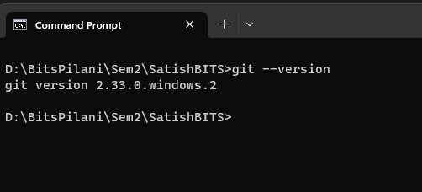
Git Basic installation/version check
Git install Command: git --version

Slide 4
i) Create Repository
First creating a local directory and initiating the directory as git repository, Create a remote repository on git, set remote URL to local repo and then push the local to remote repository. Setup the repository with user and email.
>mkdir SatishBITS
>git init SatishBITS
>git log
>git add .
>git commit -m "first commit”
>git remote add origin https://github.com/iamsatishsharma/BITS_DevOps_Assignment1.git
>git push --set-upstream origin main
Note: --set-upstream command is required when we push repo with branch to origin where it does not exists.

Slide 5
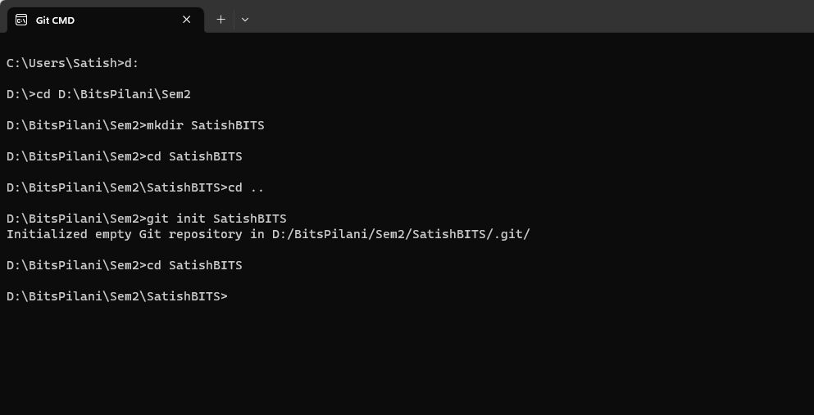
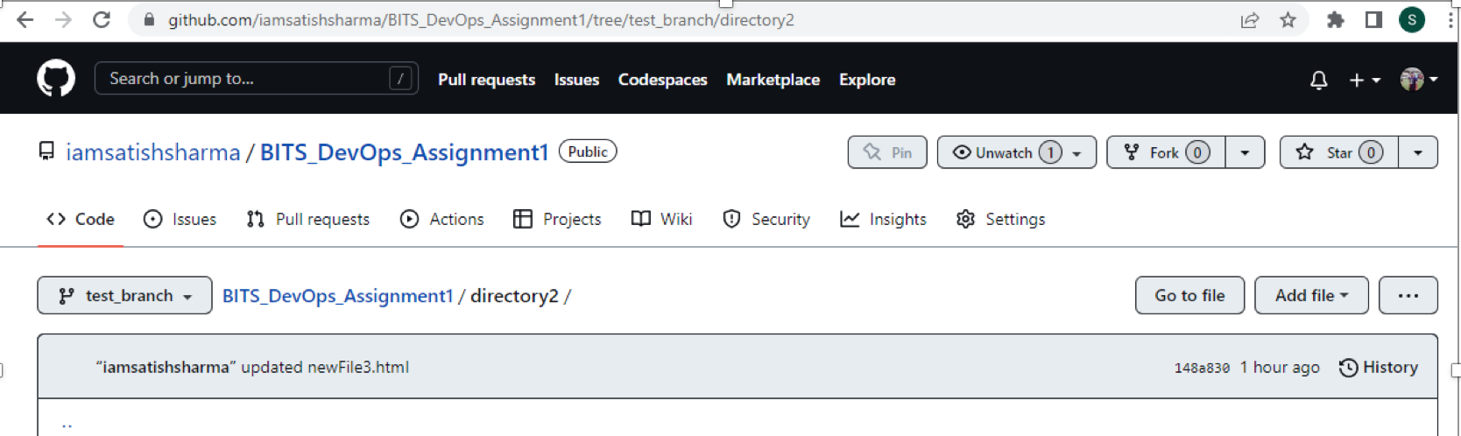
Screenshots

Slide 6
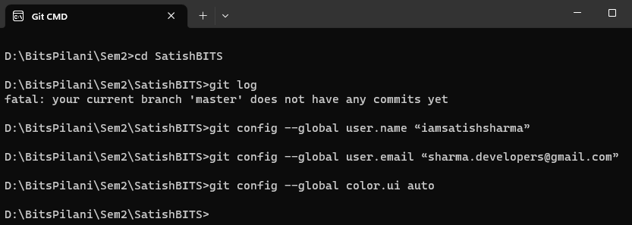
SETUP Command
git config --global user.name “iamsatishsharma”
git config --global user.email “sharma.developers@gmail.com”
git config --global color.ui auto

Slide 7
ii) Add Two Directory and some raw code files to the repository
Command:
>mkdir directory1 (to create directory1)
>mkdir directory2
>echo newFile1.html
>git add newFile1.html
>git commit -m "added a new file1 ib directory 1"
>echo "<!DOCTYPE html>" > newFile1.html
>echo newFile2.html
>git add newFile2.html
>git commit -m "added new file2"
>echo "<!DOCTYPE html>" > newFile2.html
>git commit -m "added new file2"
>echo "Put any content here" >> Newfile2.java

Slide 8
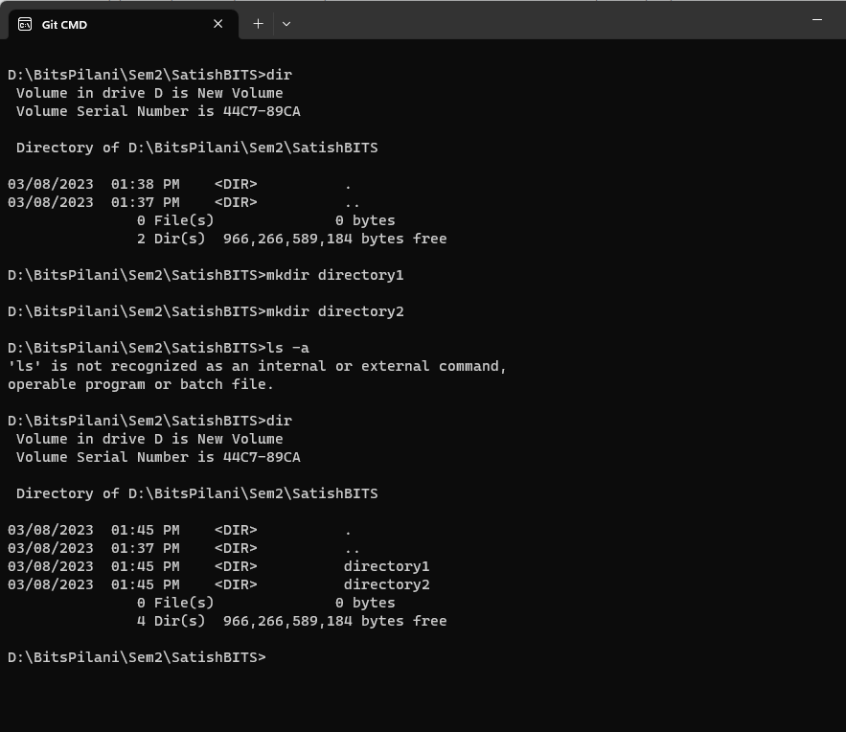
Screenshot

Slide 9
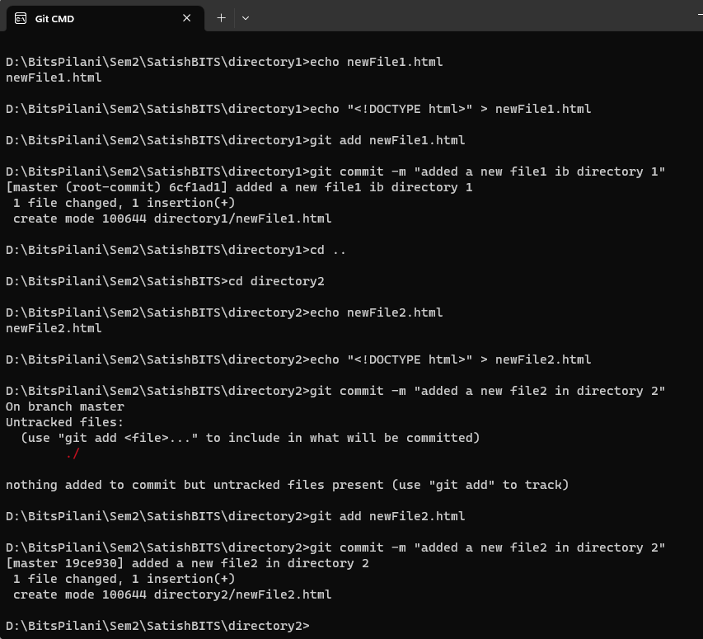
Screenshot

Slide 10
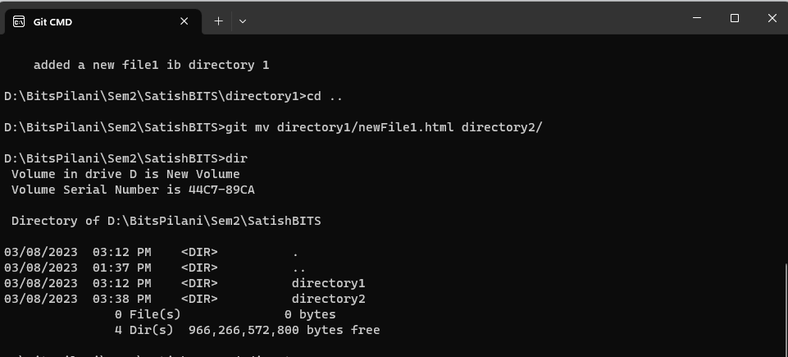
3) Move Code from One directory to Another Directory
Command:
>git mv directory1/newFile1.html directory2/----move file from directory1 to directory2
>dir
>git status

Slide 11
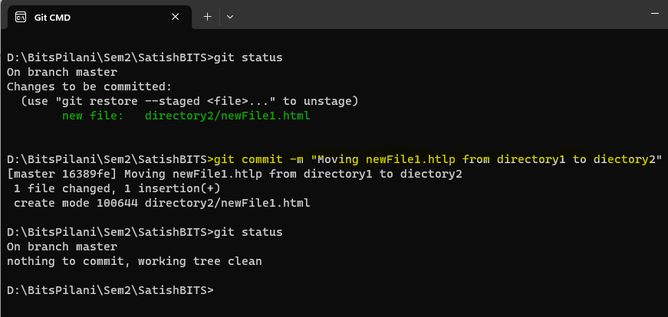
Screenshot

Slide 12
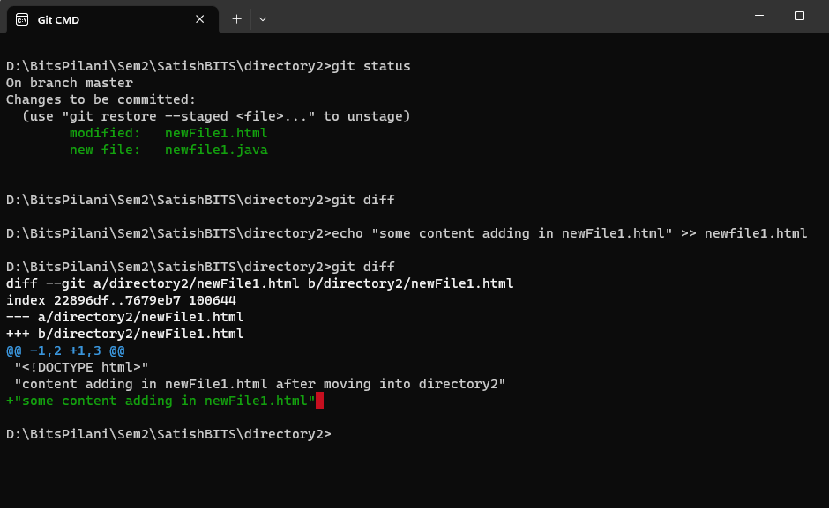
4.Update one source code file and display the difference
Command:
>git status
>git diff

Slide 13
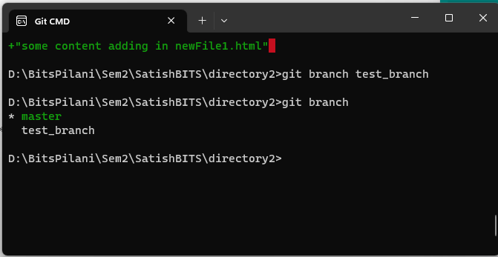
5. Create a Branch
Command:
>git branch test_branch
>git branch
13

Slide 14
6.Add some raw code to the branch
Checkout to test branch and add new file and update.
Command:
>git checkout test_branch
>git branch
>echo newFile3.html
>echo "<!DOCTYPE html>" > newFile3.html
>git commit -m "created and updated a new file3 in new branch"
>git diff master test_branch newFile1.html

Slide 15
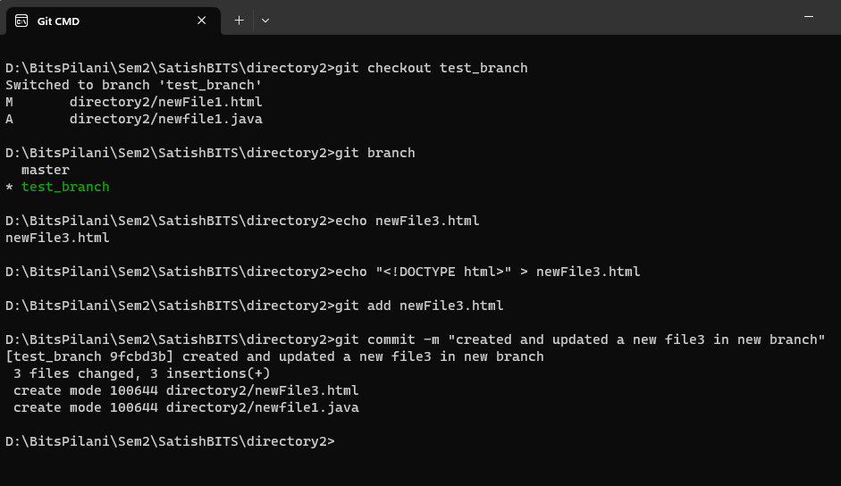
Screenshot

Slide 16
7.Merge the Branch with Main line
Command:
>git branch
> git commit -a -m "updated newFile3.html"
>git status
>git checkout master
>git branch
>git merge test_branch

Slide 17
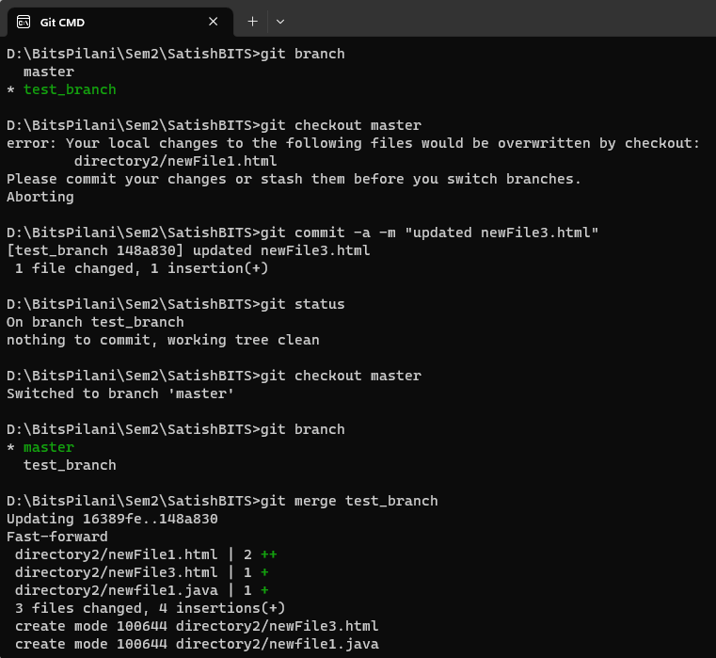
Screenshots

Slide 18
Push to remote with update
Final Push to remote:
>git remote add origin https://github.com/iamsatishsharma/BITS_DevOps_Assignment1.git
>git add .
>git commit -m ”Final commit”
>git branch -M test_branch
>git push -u origin test_branch

Slide 19
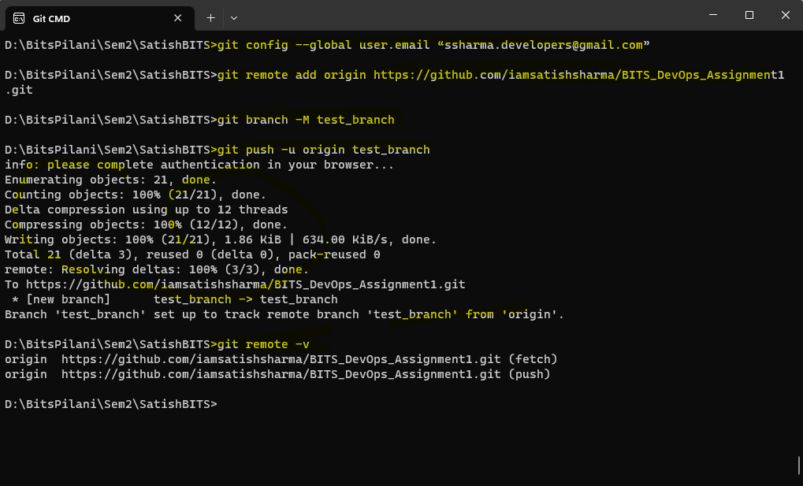
Screenshot

Slide 20
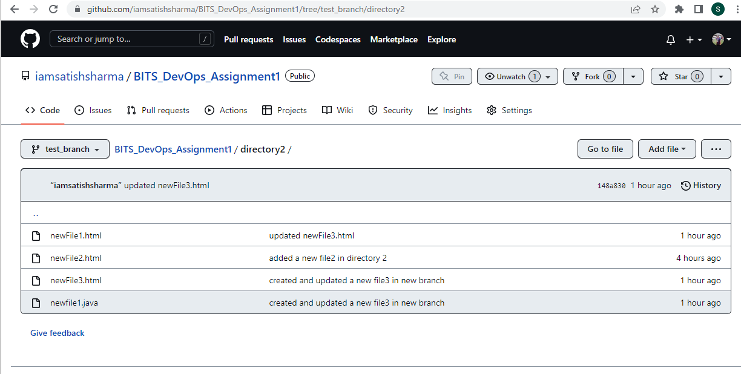
Screenshot

Slide 21
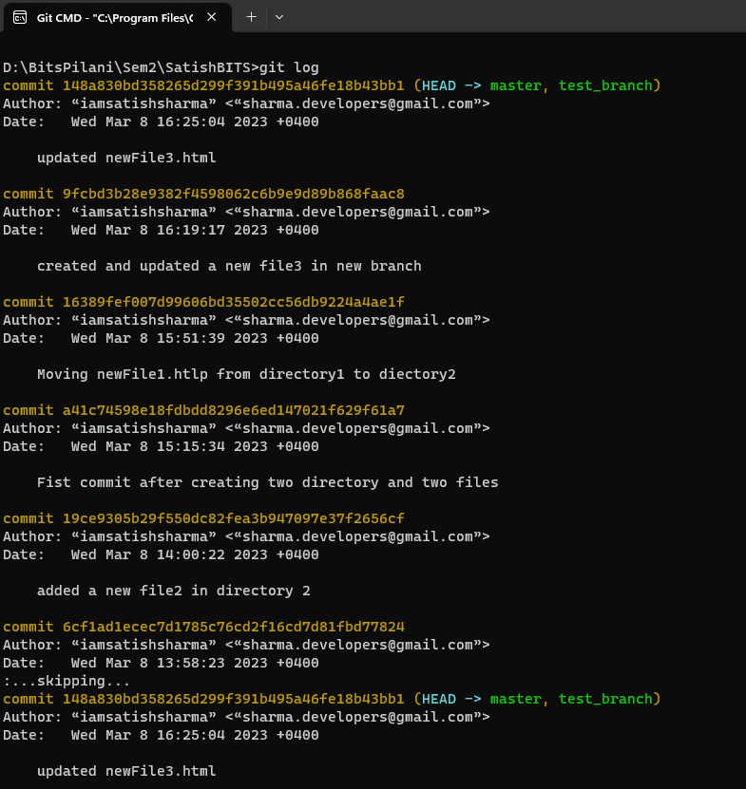
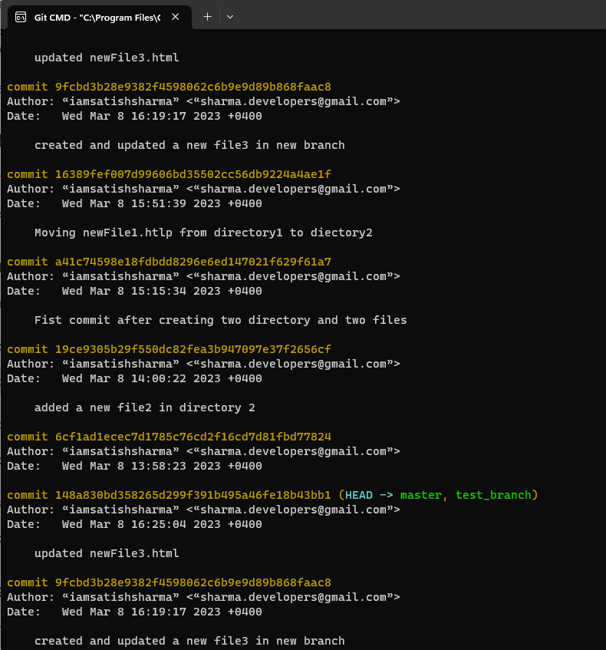
Addition: Logs to show the activity’s

Slide 22
Advantages of Moving from Centralized Source Code to Distributed Version control.
Unlike a centralized version control system (VCS), a distributed version control system enables every user to have a local copy of the running history on their machine, so if there's an outage, every local copy becomes a backup copy and team members can continue to development offline.
A distributed version control doesn't have a single point of failure, because developers clone repositories on their distributed version control workstations, creating multiple backup copies.
DVCS has the biggest advantage in that it allows you to work offline and gives flexibility. You have the entire history of the code in your own hard drive, so all the changes you will be making in your own server or to Your own repository which doesn’t require an internet connection, but this is not in the case of CVCS.
DVCS is faster than CVCS because you don’t need to communicate with the remote server for each and every command.

Slide 23
You do everything locally which gives you the benefit to work faster than CVCS.
Working on branches is easy in DVCS. Every developer has an entire history of the code in DVCS, so developers can share their changes before merging all the ‘sets of changes to the remote server.
In CVCS it’s difficult and time-consuming to work on branches because it requires to communicate with the server directly.
Merge conflicts with other developer’s code are less in DVCS. Because every developer work on their own piece of code. Merge conflicts are more in CVCS in comparison to DVCS.
DVCS has more advantages and it’s more popular than CVCS

Slide 24
Key learnings by Satish Kumar Sharma (2022MT93327)
My key learnings are summarized as below:
Learning how to use Git is even better, because it makes you understand GitHub in depth like create git repository, do changes, create branch, create directory, storing, manipulate file , tracking, manipulate and collaborating on software projects.

Slide 25
Thank You

